Slide 1
Setup QA Process
Software Quality Assurance
Telerik Software Academy
http://academy.telerik.com

Slide 2

The Lectors
Angel Tsvetkov
QA Architect
Cloud Services Division
Email: Angel.Tsvetkov@telerik.com
Blog: http://theqaangel.com/

Slide 3

THE TEAM
QA
DEV

Slide 4

THE PROJECT
WEB

Slide 5
THE ITERATION
2 WEEKS

Slide 6
Agenda
Build Solid Ground
Test In Agile Environment
Test Infrastructure
Continuous Delivery

Slide 7
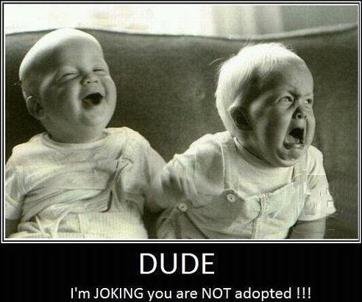
Build Solid Ground
In-Team Communication

Slide 8

Build Solid Ground
Do We Need Separate Test Process?

Slide 9
Test In Agile Environment
Everybody Testing
Definition Of Done
React On Quick Changes

Slide 10
Test In Agile Environment
UI
Service (API)
Unit
Performance
More tests
Faster execution
More stable
Fewer tests
Longer execution
More unstable

Slide 11
Test In Agile Environment
Not Done
In Progress
Ready For Test
Done
Not Done
Planned
In Progress
Ready For Test
Ready For Release
In Testing
Released

Slide 12


BONUS: Continues integration (CI)
feature branch
TEST
master branch
12

Slide 13
BONUS: Continues integration (CI)
Fail early
Reduce the risk
Reduce the overhead
Enable automated testing
Increase confidence
13

Slide 14
Test Infrastructure
DEV
Development environment
Deployment during development
Deploy very often
Potentially not stable
Development

Slide 15
Test Infrastructure
ST
System Testing environment
Verify base functionality
Deploy very often
Potentially not stable
System

Slide 16
Test Infrastructure
SIT
System Integration Testing environment
Verify integration points
Verify base functionality
Suitable for *resilience testing
System Integration

Slide 17
Test Infrastructure
UAT
User Acceptance Testing environment
Suitable for manual testing
Suitable for *performance testing
Verify integration points
Verify base functionality
Stable
User Acceptance

Slide 18
Test Infrastructure
Live
Live / Production environment
Stable ☺
Live

Slide 19
Test Infrastructure
ST
SIT
UAT
LIVE
System
System Integration
User Acceptance
Live
UI Testing
Unit Testing
Performance Testing
Manual Testing
Service Testing

Slide 20
Test (Execution) Infrastructure
Scalability
Execution Mechanism
Topology

Slide 21

Test (Execution) Infrastructure
Service Tests
Performance Tests
UI Tests

Slide 22

Test (Execution) Infrastructure
Service Tests
Performance Tests
UI Tests

Slide 23

Test (Execution) Infrastructure
master
S-1
S-2
S-N
slave
slave
slave

Slide 24
Test (Execution) Infrastructure
master
LABEL
S-N
S-1
S-2
slave
slave
slave

Slide 25
Test (Execution) Infrastructure
Install
Views
Jobs (Projects)

Slide 26
Continuous Delivery
ST
SIT
UAT
LIVE
System
System Integration
User Acceptance
Live
API
API
Integration
API
Integration

Slide 27



Continuous Delivery
11.6 sec
10-12 h
2-3 days

Slide 28
Continuous Delivery
30 times more often releases
8000 times faster deployment
50% fewer failed deployments
restore service 12 times faster
Speed
Quality
Time
Focus

Slide 29
Setup QA Process
?
?
?
?
?
Questions?
?
?
?
?
?
?

Slide 30




Free Trainings @ Telerik Academy
C# Programming @ Telerik Academy
csharpfundamentals.telerik.com
Telerik Software Academy
academy.telerik.com
Telerik Academy @ Facebook
facebook.com/TelerikAcademy
Telerik Software Academy Forums
forums.academy.telerik.com

